Slide 1
Performance Comparison of CatGAN using different Facial Expression Recognition Datasets
23rd July 2020
Junyeob Kim*, Marshall**, Jang-Sik Park**
*Dept. of Engineering, University of Cambridge
**Dept. of Electronic Eng., Kyungsung University
jun9584@gmail.com

Slide 2
Motivation
Each deep learning dataset is generated in different environment,
Probability distributions of each dataset must be different.
The performance of deep learning models should change depending on the input datasets.
Moreover, within a network, there are several hyperparameters.
Changing these hyperparameters should improve the performance of the network or make the training and validation process more effective.
Facial Expression Recognition^{[1]} (FER) datasets are used, as there are various datasets available.
S. Li and W. Deng, “Deep Facial Expression Recognition: A Survey,” IEEE Transactions on Affective Comput.

Slide 3
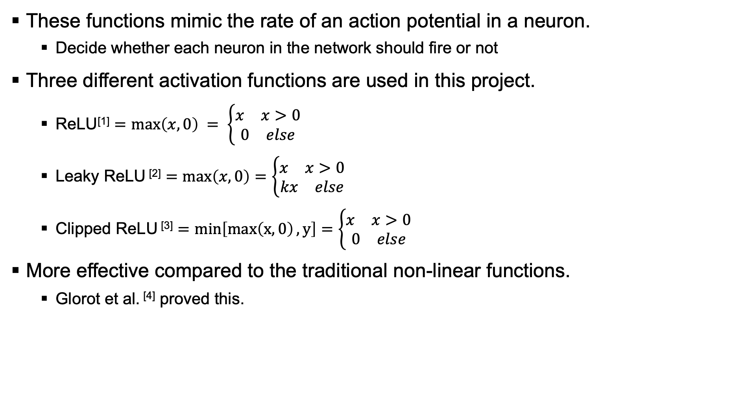
Hyperparameters – activation functions
These functions mimic the rate of an action potential in a neuron.
Decide whether each neuron in the network should fire or not
Three different activation functions are used in this project.
ReLU^{[1]} $=\max\left(x,0\right) = \left\{\begin{aligned}\begin{matrix}x & x>0\end{matrix} \\ \begin{matrix}0 & else\end{matrix}\end{aligned}\right.$
Leaky ReLU ^{[2]} $=\max\left(x,0\right)=\left\{\begin{aligned}\begin{matrix}x & x>0\end{matrix} \\ \begin{matrix}kx & else\end{matrix}\end{aligned}\right.$
Clipped ReLU ^{[3]} $=min\left[\max\left(x,0\right), y\right]=\left\{\begin{aligned}\begin{matrix}x & x>0\end{matrix} \\ \begin{matrix}0 & else\end{matrix}\end{aligned}\right.$
More effective compared to the traditional non-linear functions.
Glorot et al. ^{[4]} proved this.
V. Nair and G. E. Hinton. “Rectified Linear Units Improve Restricted Boltzmann Machines,” ICML, pp. 807–814, 2010.
A. L. Maas, A. Y. Hannun, A. Y. Ng, “Rectifier nonlinearities improve neural network acoustic models,” ICML, Vol. 30, 2013.
A. Hannun et al., “Deep Speech: Scaling up end-to-end speech recognition,” http://arxiv.org/abs/1412.5567, 2014.
X. Glorot, A. Bordes, Y. Bengio, “Deep Sparse Rectifier Neural Networks,” AISTATS, Vol. 15, pp. 315–323, 2011.

Slide 4
Hyperparameters - optimizers
Principle – to reach the local minimum of the objective function
Each optimizer approaches in their own methods, so the process is different.
Rosenbrock^{[1]} and Himmelblau^{[2]} functions are used to compare the performance of each optimizer.
Two optimizers, gradient descent and newton method are tested with above functions
H. H. Rosenbrock, “An Automatic Method for Finding the Greatest or Least Value of a Function,” The Computer Journal, Vol. 3, no. 3, pp. 175–184, 1960.
D. M. Himmelblau, “Applied Nonlinear Programming,” McGraw-Hill Book Company, New York, New York, 1972.

Slide 5
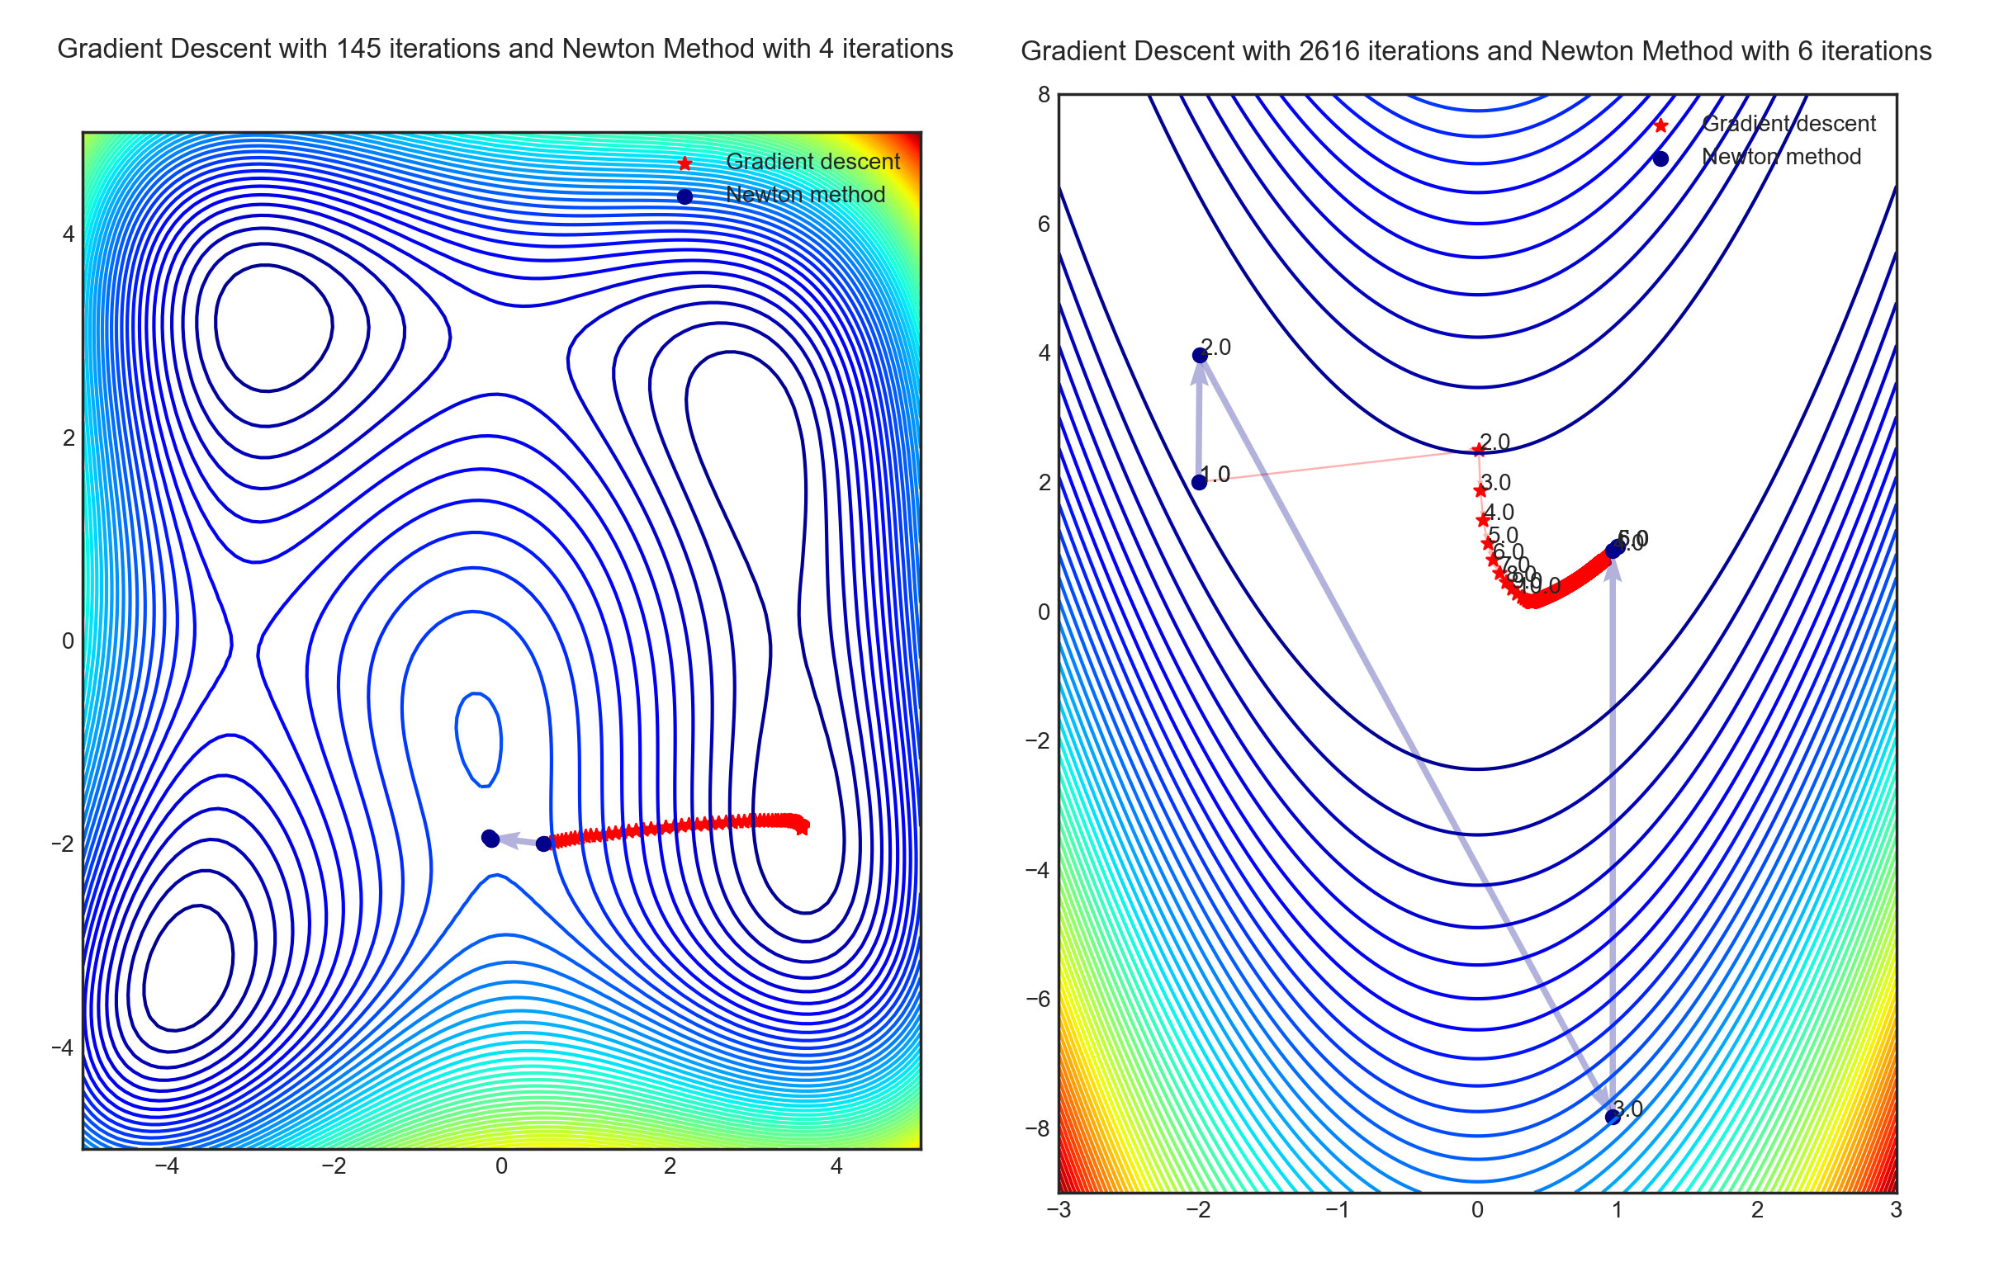
Optimizer comparison with two equations
Figure 1. Gradient Descent (Red) and Newton Method (Blue) on Himmelblau (Left) and Rosenbrock (Right) Functions.

Slide 6
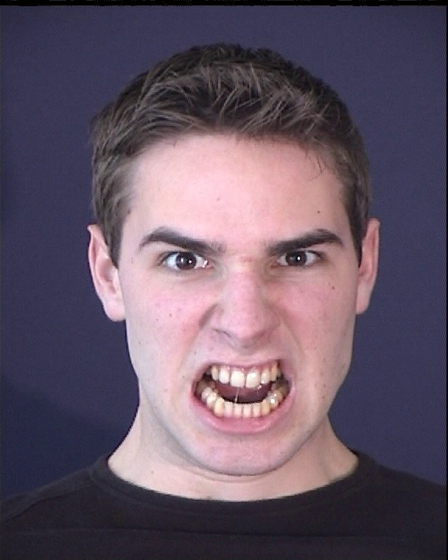
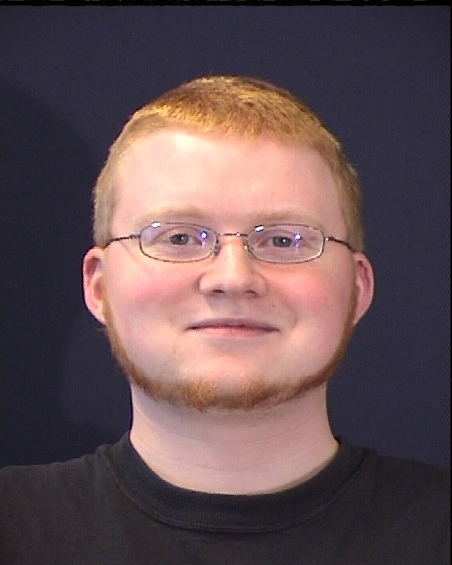
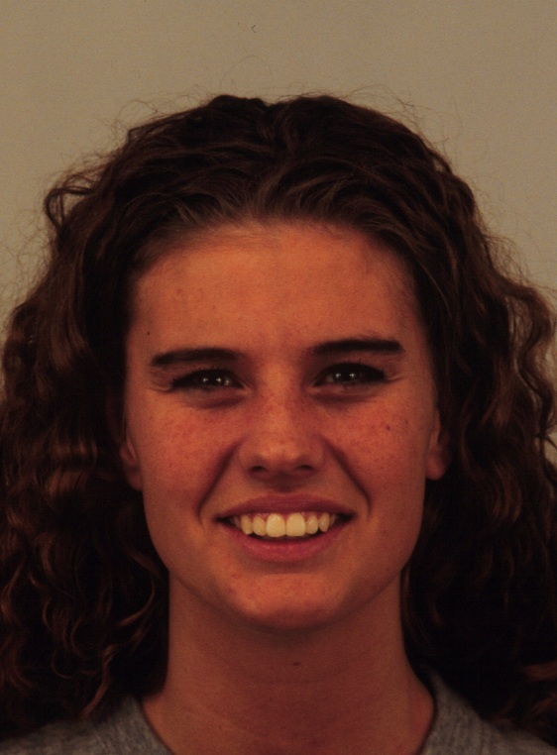
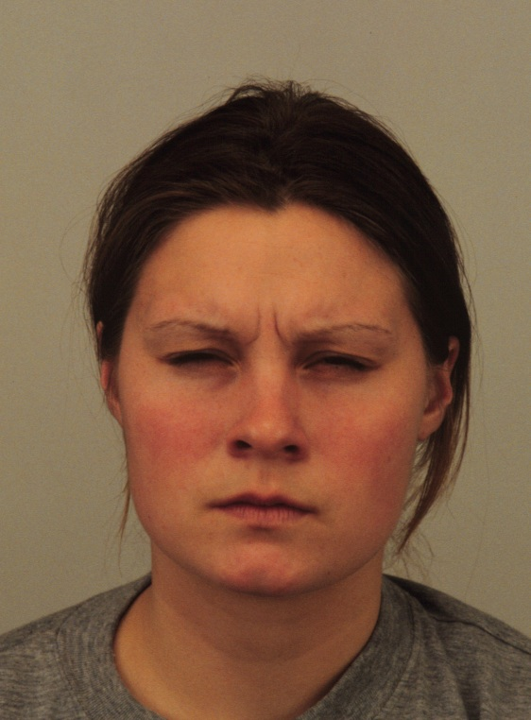
Dataset investigation
Two FER datasets are used – MMI^{[1]} and KDEF ^{[2]}
Figure 2. Sample images from MMI (left) and KDEF (right) datasets.
M. Pantic, M. Valstar, R. Rademaker, L. Maat, "Web-based database for facial expression analysis," Proc. 13th ACM Int'l Conf. Multimedia (Multimedia '05), pp. 317-321, 2005.
M. G. Calvo, D. Lundqvist, “Facial expressions of emotion (KDEF): Identification under different display-duration conditions,” Behav Res, Vol. 40, no. 1, pp. 109–115, 2008.

Slide 7
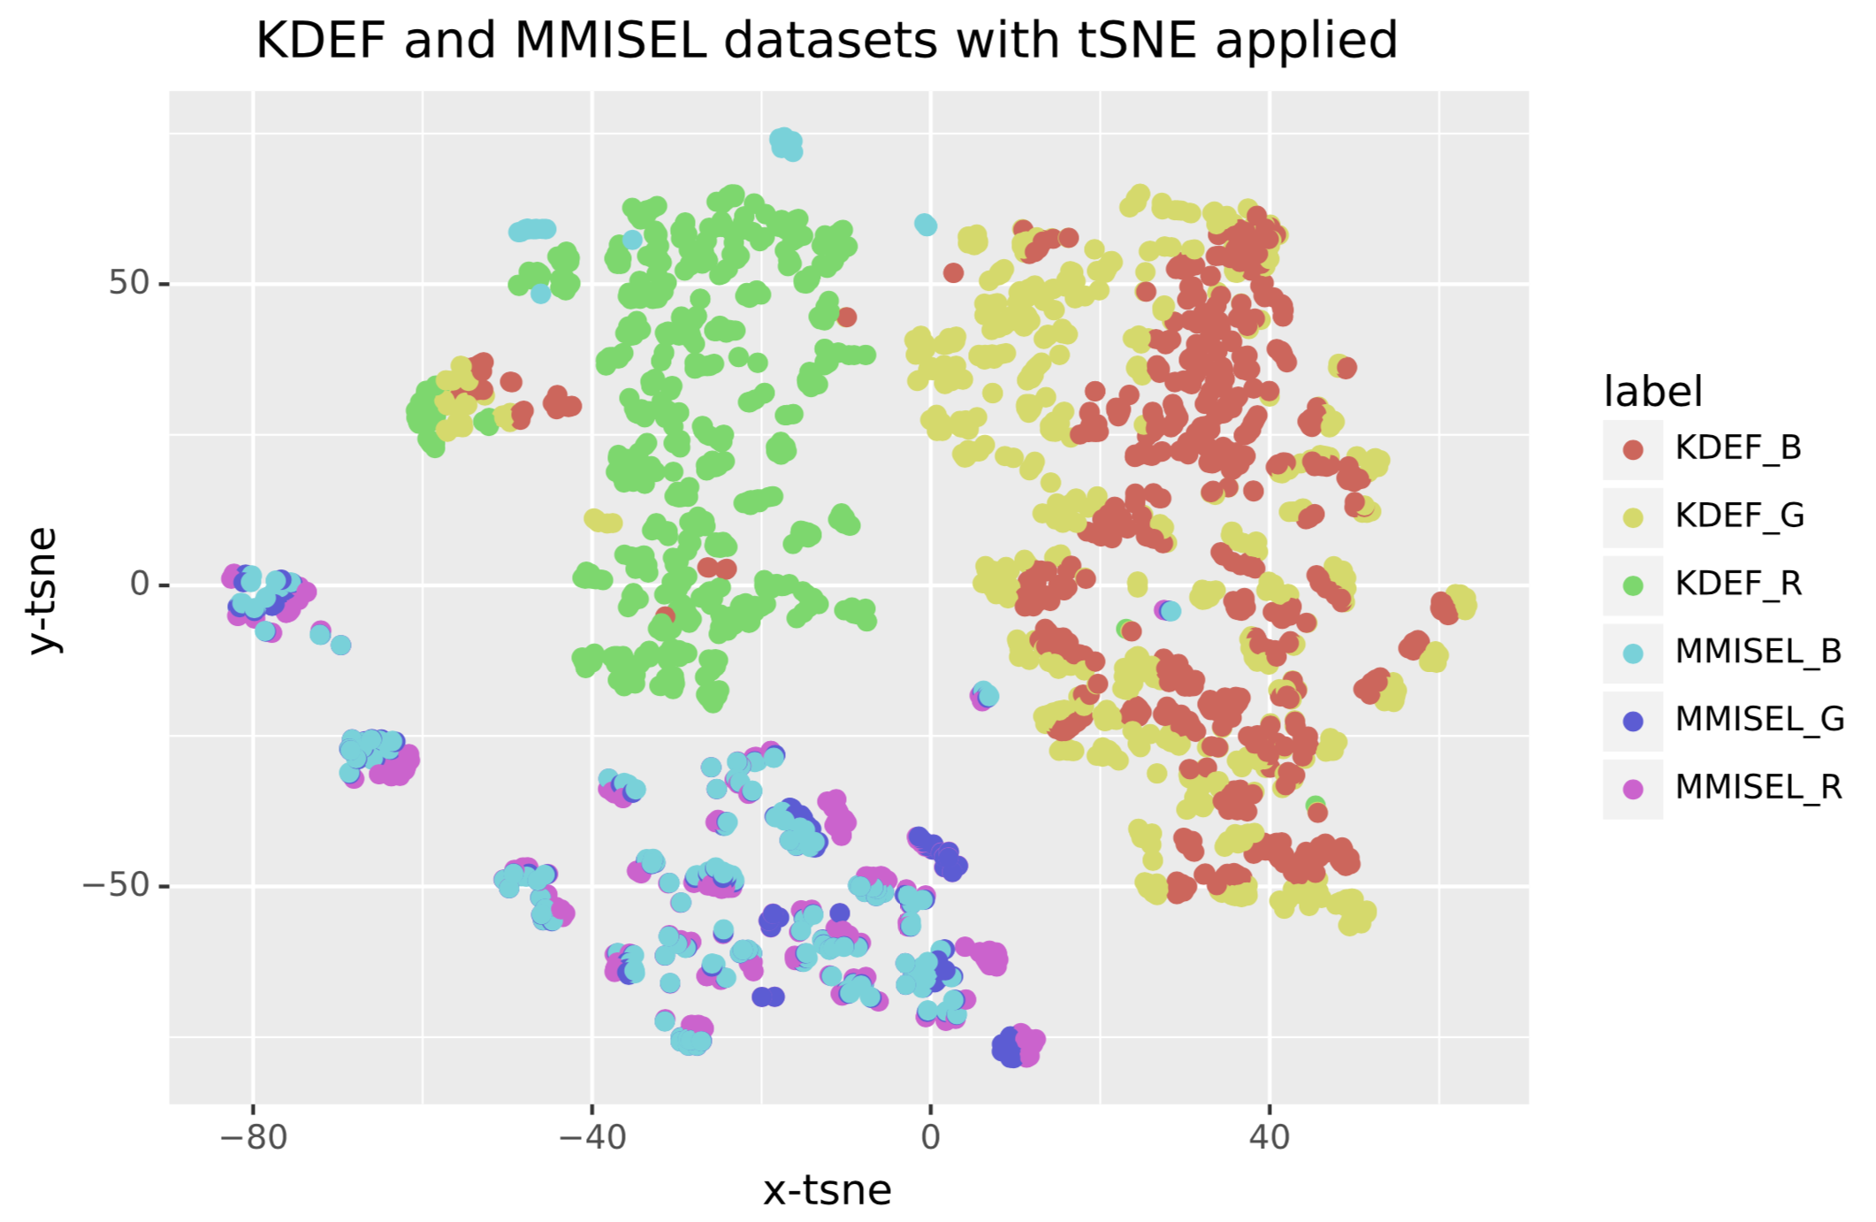
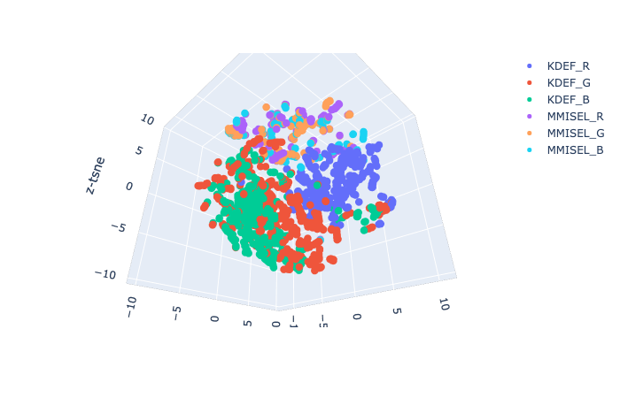
Dataset investigation - T-SNE
T-SNE ^{[1]}, a method to perform dimensionality reduction, has been applied
It is possible to observe that distributions of KDEF and MMI datasets can easily be distinguished
Figure 3. Result of 3D (left) and 2D (right) T-SNE applied to MMI and KDEF datasets.
L. van der Maaten and G.E. Hinton, “Visualizing High-Dimensional Data Using t-SNE,” J. Machine Learning Research, Vol. 9, pp. 2579-2605, 2008.

Slide 8
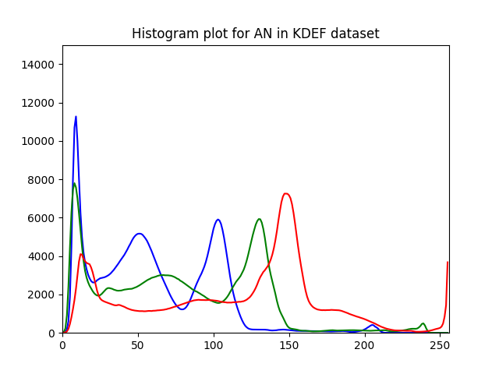
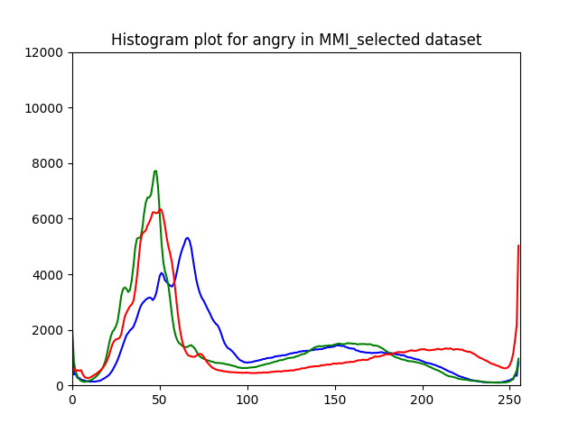
Visualizing with Mixture of Gaussian
Each dataset has been plotted to show that the result of T-SNE represent the difference in the probability distribution of the datasets.
It is possible to observe that each distributions contain different mixtures of Gaussian distributions
Figure 4. RGB distributions of KDEF (Left) and MMI (Right) for angry facial expression.

Slide 9
CatGAN^{[1]}
A variation of GAN which enables semi - supervised learning.
Unlike the original GAN, CatGAN aims to improve the performance of the discriminator.
Which performs classification tasks.
In order to investigate the performance of the network, three different optimizers and activation functions are used.
Optimizers: Adam, RMSProp, SGDM
Activation functions: ReLU, Leaky ReLU, Clipped ReLU
J. T. Springenberg . Unsupervised and Semi-Supervised Learning with Categorical Generative Adversarial Networks. ICLR 2016.

Slide 10
Process of GAN^{[1]}
Generative Adversarial Network – a network to perform unsupervised training.
Update Models
Uniform Distribution
Generator
Fake Data
Discriminator
Losses
Inverse Transform Sampling
Real Data
I. J. Goodfellow, J. Pouget-Abadie, M. Mirza, B. Xu, D. Warde-Farley, S. Ozair, A. Courville, Y. Bengio.
Generative Adversarial Nets. Adv Neural Inf Process Syst, 2014, 27.

Slide 11
Experiment summary
Used the same architecture in the paper, for CIFAR-10 dataset.
Used Google CoLaboratory for the execution of the program.
Written in Tensorflow
Experiment settings are shown below
 | MMI | KDEF
Train set | 187 | 588
Test set | 80 | 251
Input image dimension | 60×48×3
Batch size | 45
Epoch | 50
Input noise dimension | 128
Learning rate | 0.0001

Slide 12
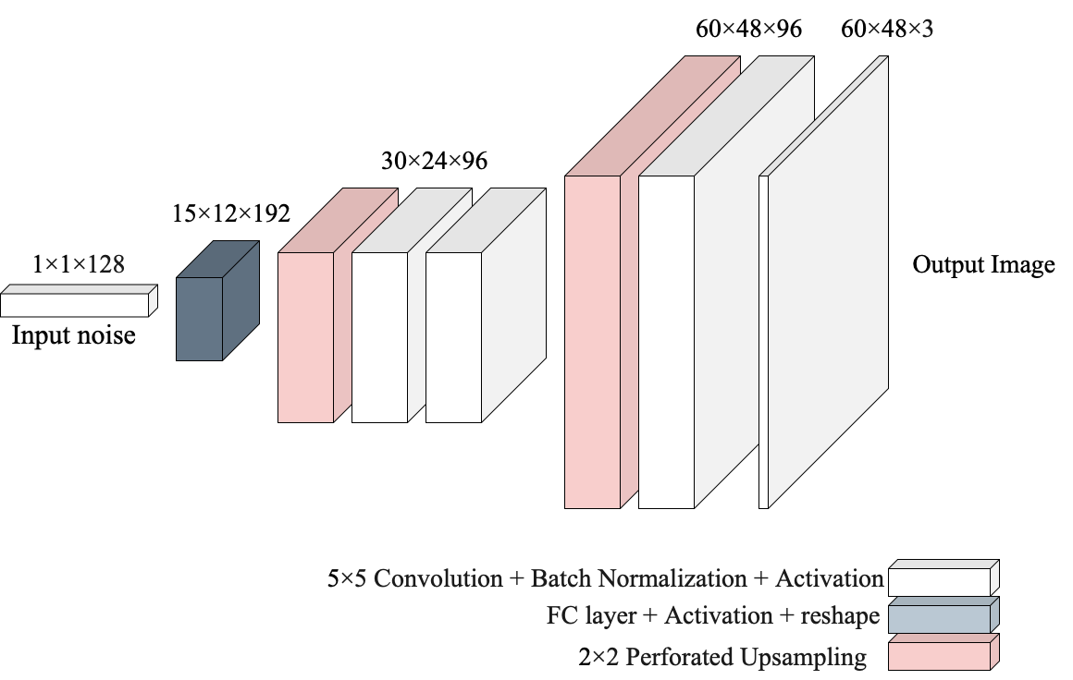
Model summary - Generator

Slide 13
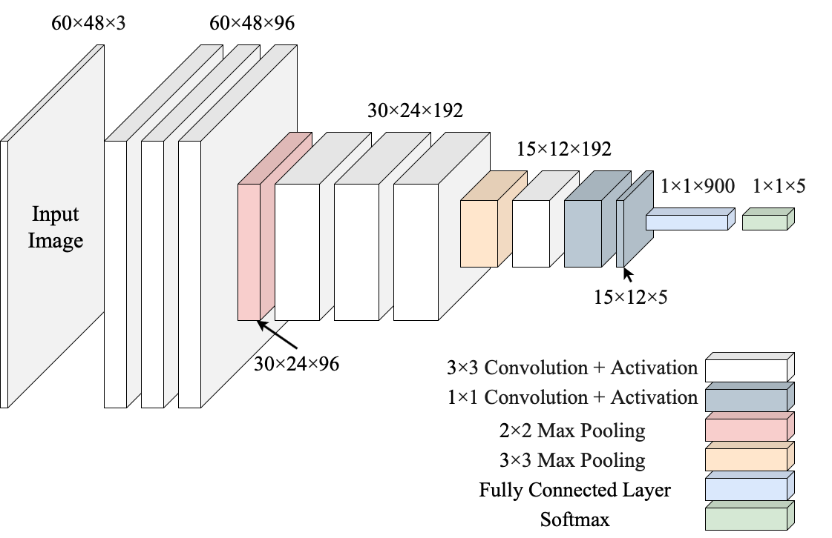
Model summary - Discriminator

Slide 14
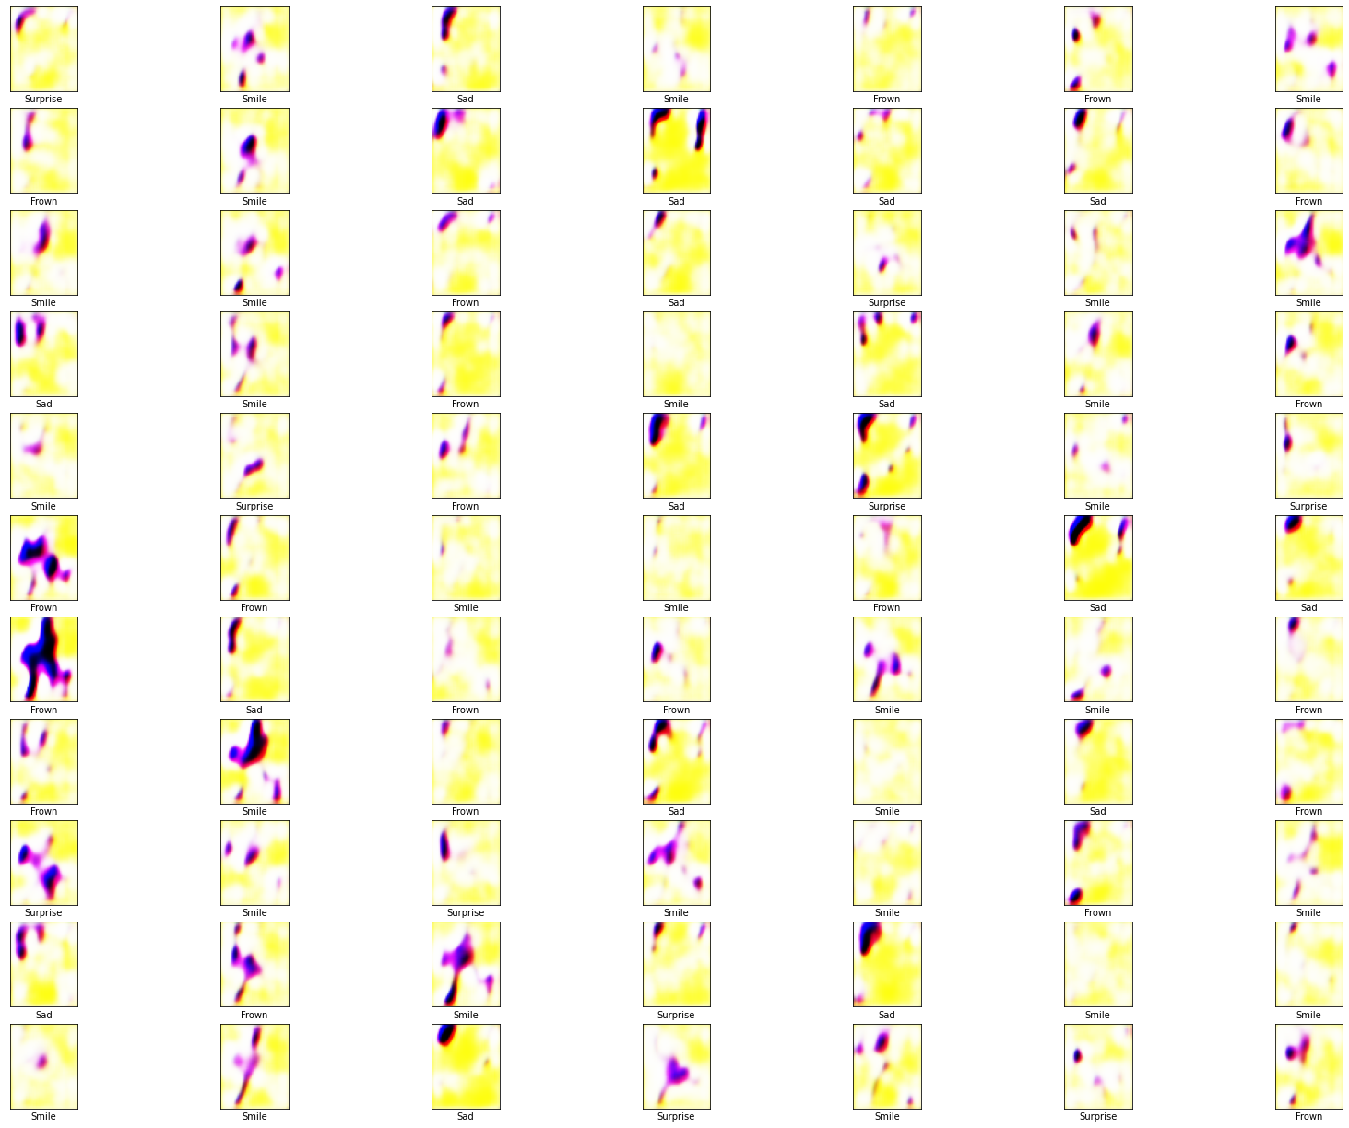
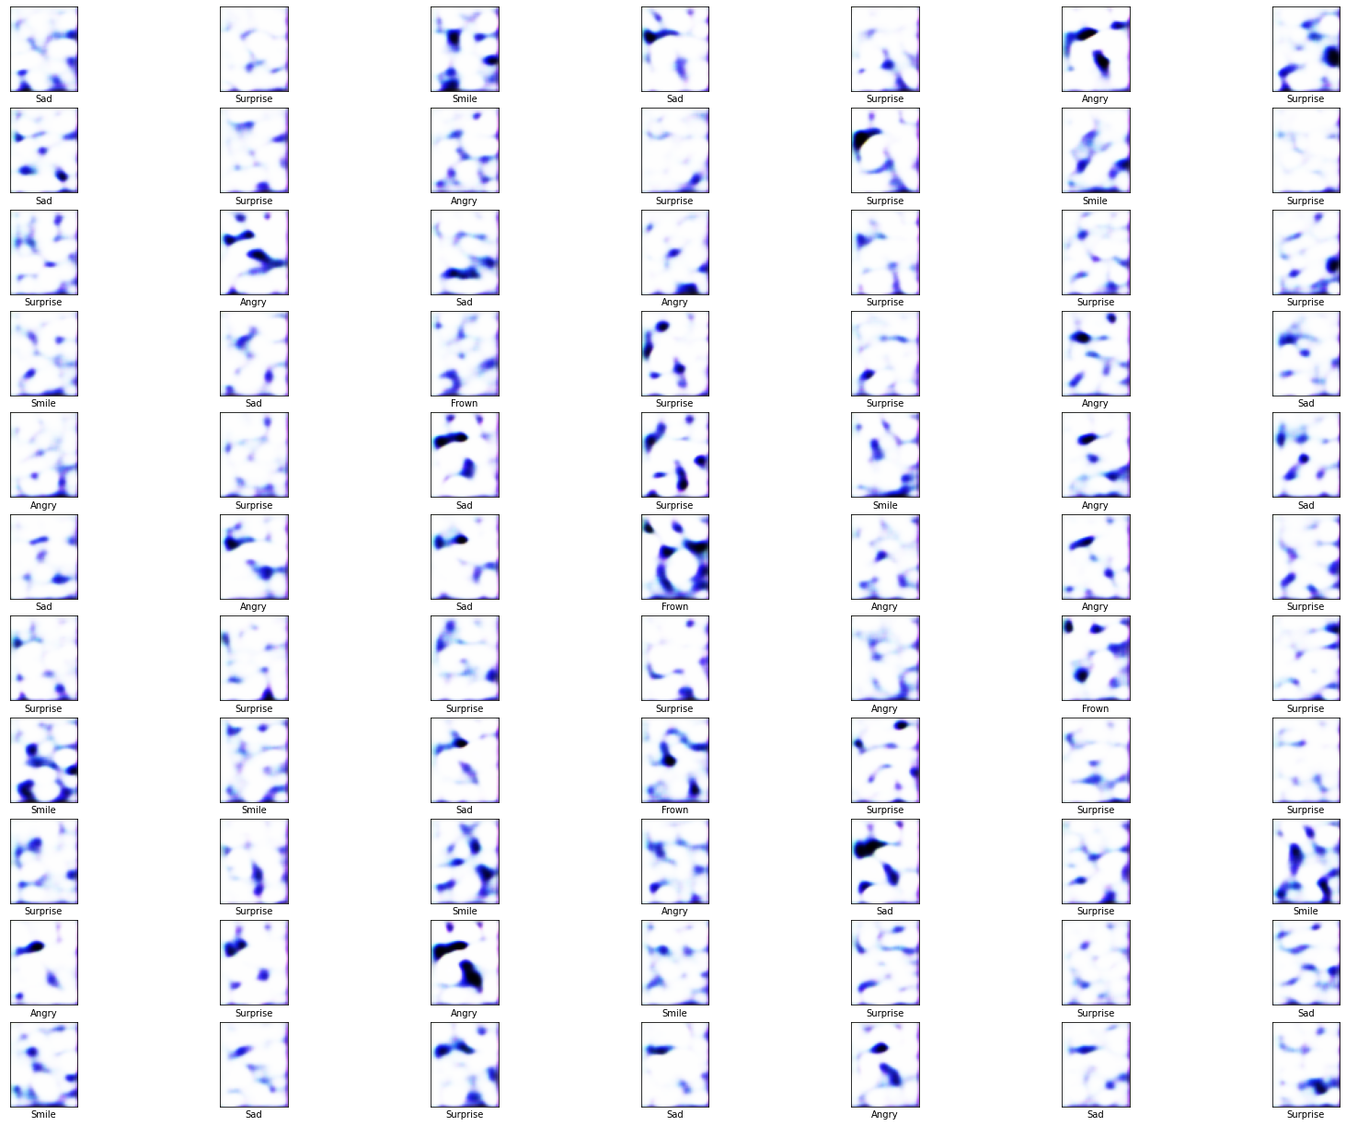
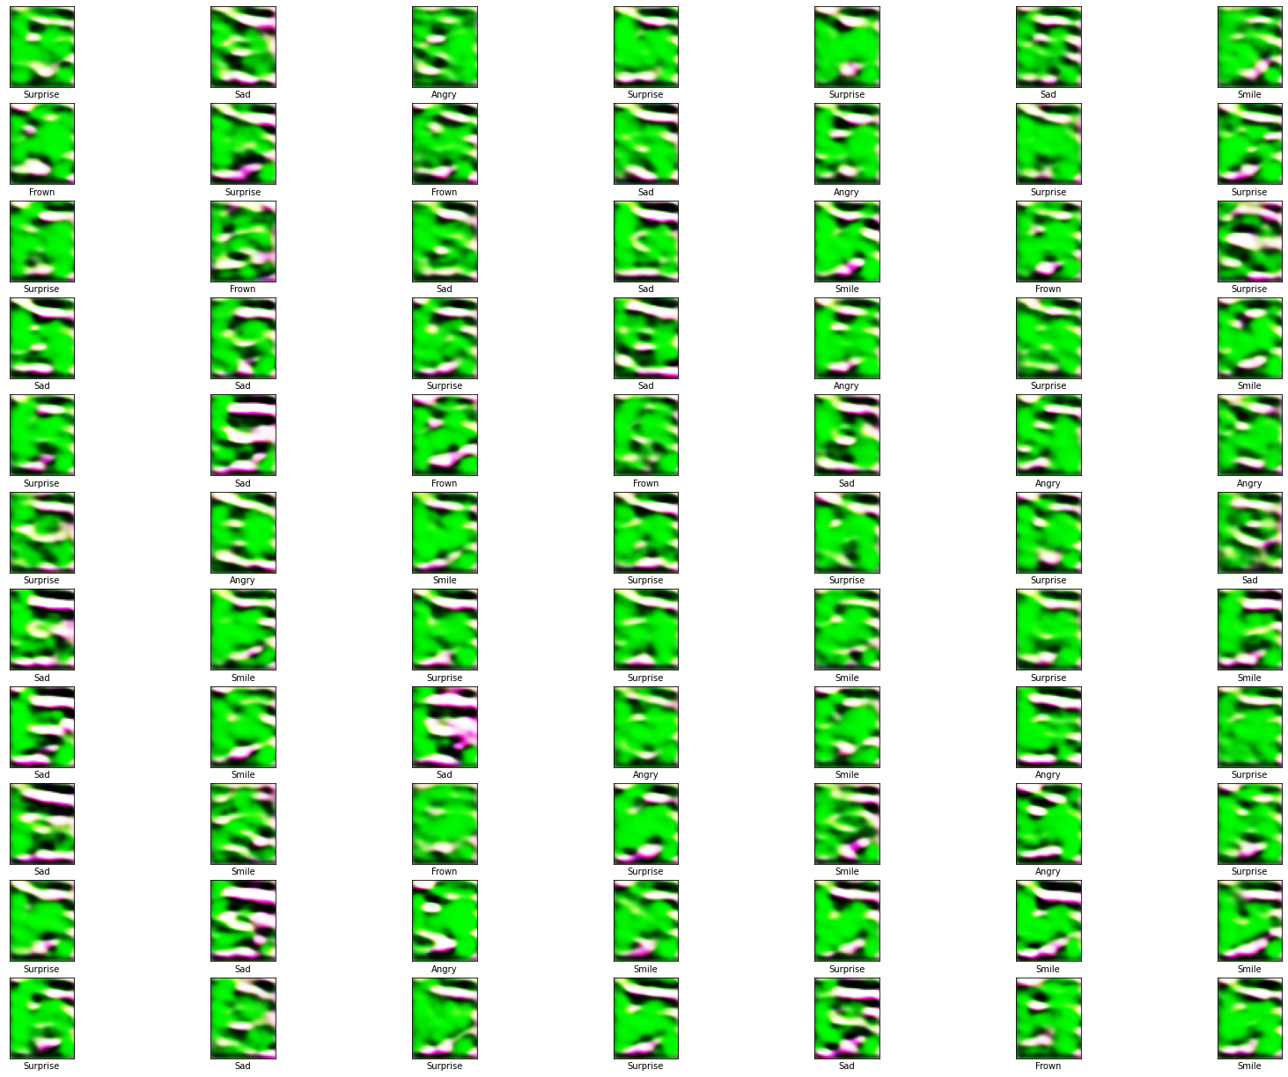
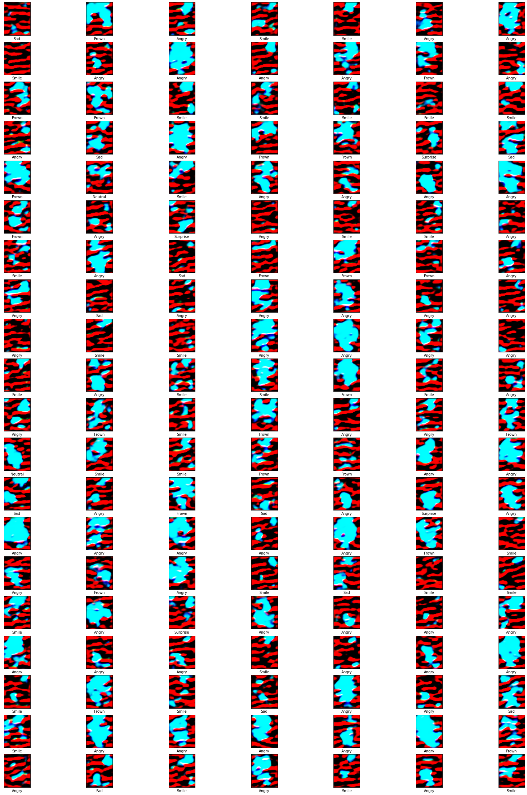
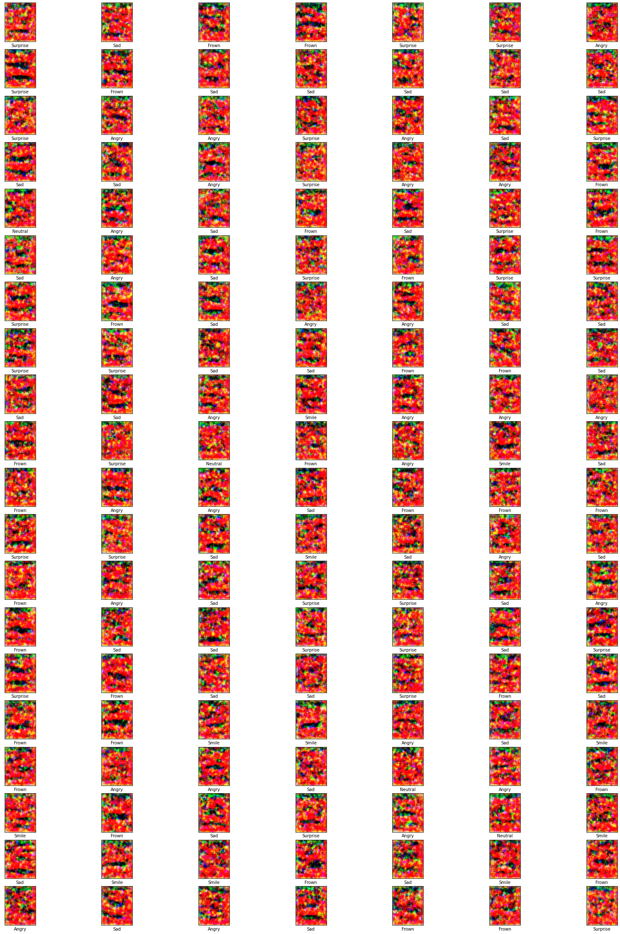
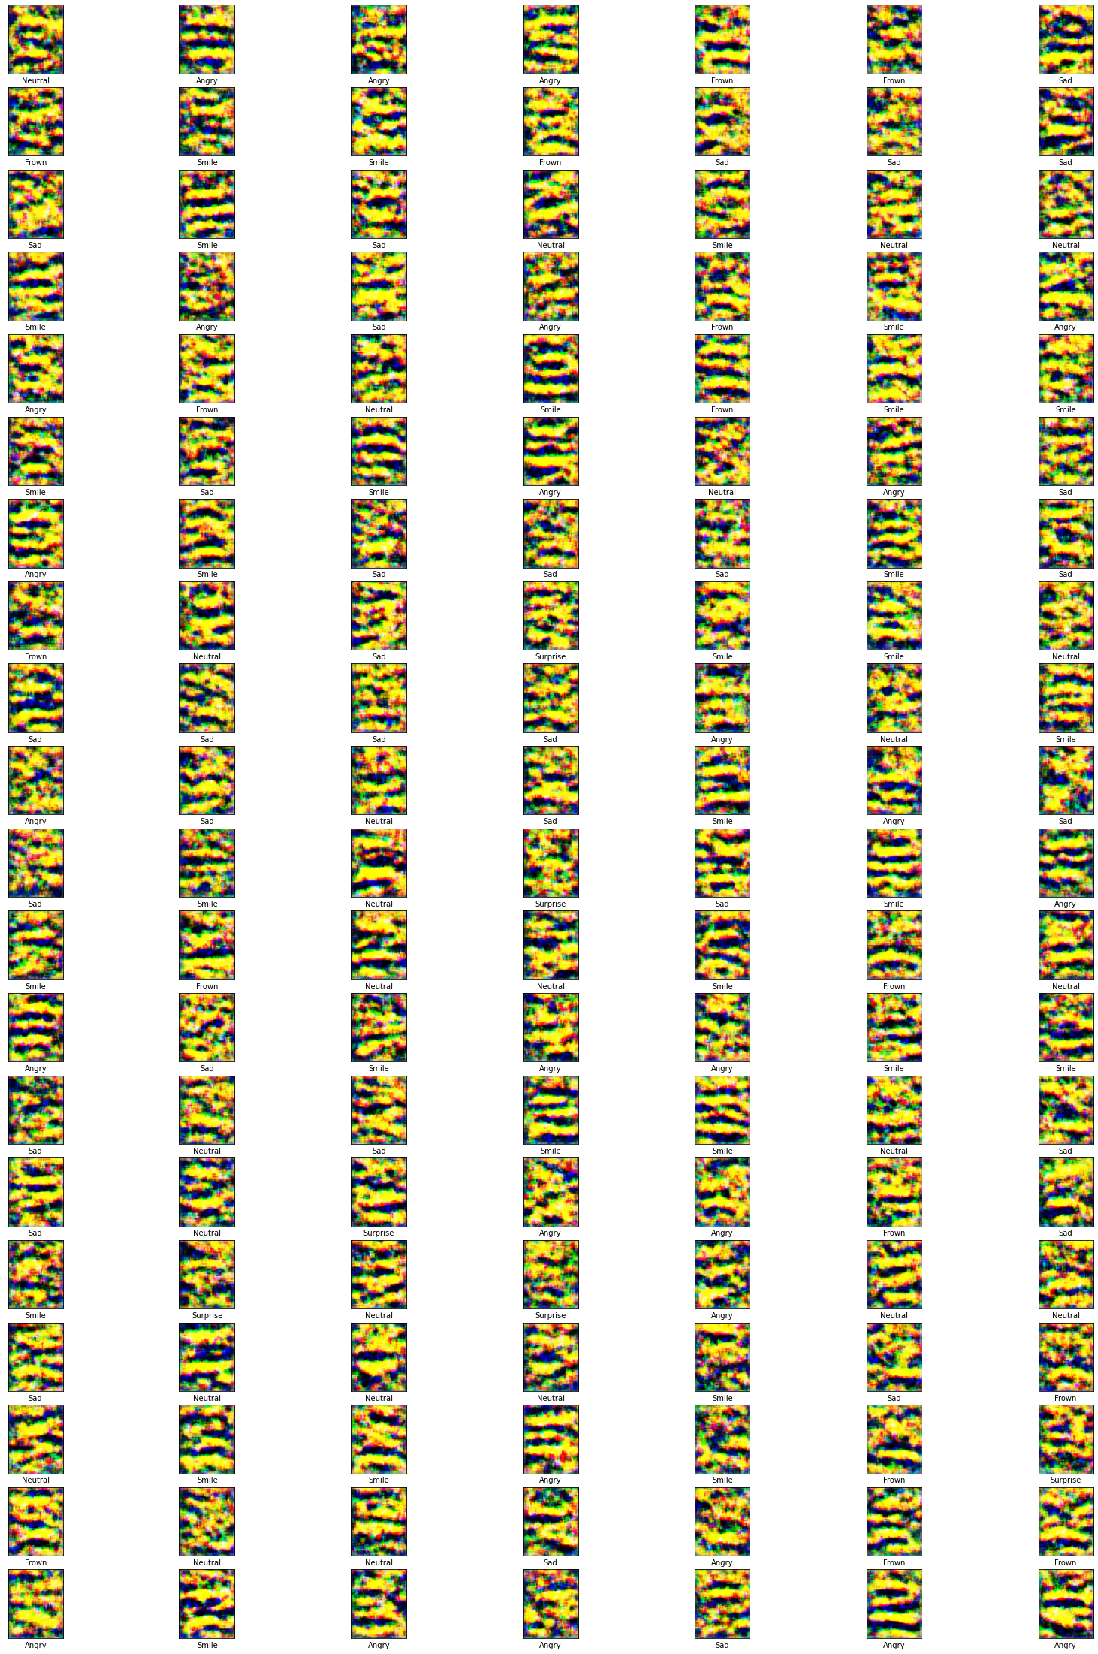
Results - Generator
ReLU + Adam | Clipped ReLU + RMSProp | Leaky ReLU + Adam | Leaky ReLU + RMSProp | ReLU + SGDM | Clipped ReLU + SGDM
MMI Dataset |  |  | KDEF dataset

Slide 15
Results - Discriminator

Slide 16
Results
KDEF
839 images |  |  | Train = 588 |  |  | Test = 251 |  | Learning rate = 1e-4
 | Adam |  |  |  | RMSProp |  |  | SGDM
 | Relu | ClippedRelu | LeakyRelu | LeakyRelu | Relu | ClippedRelu | LeakyRelu | Relu | ClippedRelu | LeakyRelu
Accuracy (%) | 81.25 | 100 | 0.9875 | 98.75 | 75 | 100 | 81.25 | 32.5 | 100 | 33.75
MMI selected
267 images |  |  | Train = 187 | Train = 187 |  | Test = 80 |  | Learning rate = 1e-4
 | Adam |  |  |  | RMSProp |  |  | SGDM
 | Relu | ClippedRelu |  | LeakyRelu | Relu | ClippedRelu | LeakyRelu | Relu | ClippedRelu | LeakyRelu
Accuracy (%) | 100 | 100 |  | 100 | 97.21 | 100 | 98.80 | 75.3 | 100 | 93.23
With current discriminator network, Clipped ReLU resulted with the best performance, regardless of the hyperparameters.
Notes:
Small dataset but acceptable for our purpose
Confusion matrix & result images

Slide 17
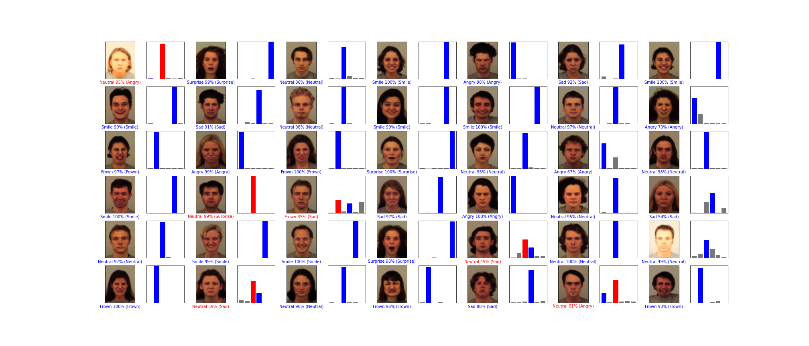
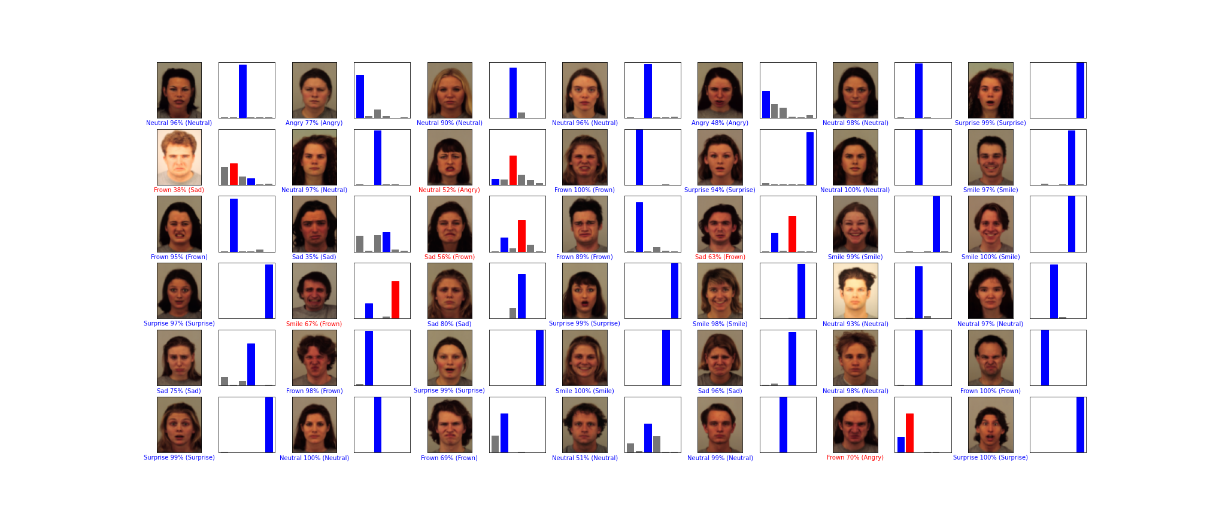
Results – Confusion matrix
It is possible to see that for images with incorrect labels, their facial expression is very similar to the output label from the discriminator

Slide 18
Conclusion
Experiment showed that there are some differences in the performance of CatGAN between MMI and KDEF dataset.
These Two datasets have distinguishable features, that can be represented with MoGs.
Overall, understanding the differing nuances between datasets, and setting them as another hyperparameter for network training might improve the performance of the networks.

